Slide 1
A Mathematical Look at the Electoral College
Dr. Christopher Sears

Slide 2
Outline
The Electoral College
Tools for my Project
Historical Unfairness
Evening the Playing Field
Winner Take Some

Slide 3
The Electoral College

Slide 4
U.S. Constitution - Article Two, Section 1
Each State shall appoint, in such Manner as the Legislature thereof may direct, a Number of Electors, equal to the whole Number of Senators and Representatives to which the State may be entitled in the Congress: but no Senator or Representative, or Person holding an Office of Trust or Profit under the United States, shall be appointed an Elector.

Slide 5
U.S. Constitution - 12th Amendment
The Electors shall meet in their respective states, and vote by ballot for President and Vice-President, one of whom, at least, shall not be an inhabitant of the same state with themselves; they shall name in their ballots the person voted for as President, and in distinct ballots the person voted for as Vice-President, and they shall make distinct lists of all persons voted for as President, and all persons voted for as Vice-President and of the number of votes for each, which lists they shall sign and certify, and transmit sealed to the seat of the government of the United States, directed to the President of the Senate;
The President of the Senate shall, in the presence of the Senate and House of Representatives, open all the certificates and the votes shall then be counted;

Slide 6
U.S. Constitution - 12th Amendment
The person having the greatest number of votes for President, shall be the President, if such number be a majority of the whole number of Electors appointed; and if no person have such majority, then from the persons having the highest numbers not exceeding three on the list of those voted for as President, the House of Representatives shall choose immediately, by ballot, the President. But in choosing the President, the votes shall be taken by states, the representation from each state having one vote; a quorum for this purpose shall consist of a member or members from two-thirds of the states, and a majority of all the states shall be necessary to a choice. And if the House of Representatives shall not choose a President whenever the right of choice shall devolve upon them, before the fourth day of March next following, then the Vice-President shall act as President, as in the case of the death or other constitutional disability of the President.

Slide 7
U.S. Constitution - 12th Amendment
The person having the greatest number of votes as Vice-President, shall be the Vice-President, if such number be a majority of the whole number of Electors appointed, and if no person have a majority, then from the two highest numbers on the list, the Senate shall choose the Vice-President; a quorum for the purpose shall consist of two-thirds of the whole number of Senators, and a majority of the whole number shall be necessary to a choice. But no person constitutionally ineligible to the office of President shall be eligible to that of Vice-President of the United States.

Slide 8
Tools for the Project

Slide 9
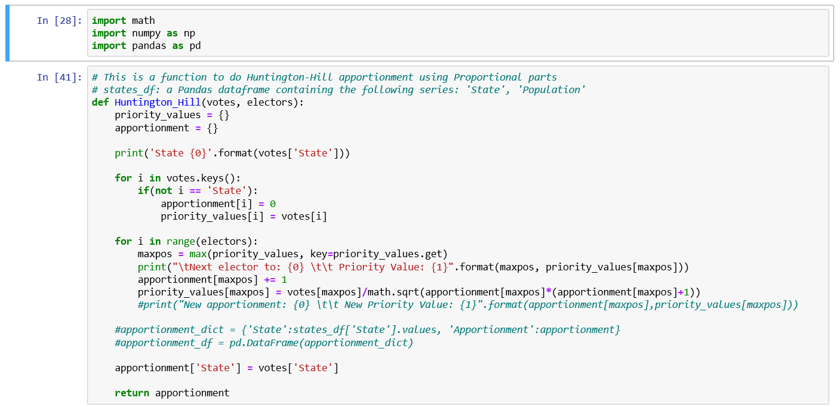
Python

Slide 10

How I Think in Computing
By Bilby - Own work, CC BY 3.0, https://commons.wikimedia.org/w/index.php?curid=10858630

Slide 11

Jupyter Notebook

Slide 12
Historical Unfairness

Slide 13
First Hypothesis:
The Electoral College is more unfair than ever.

Slide 14
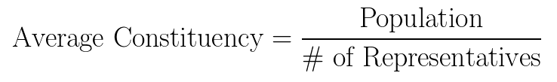
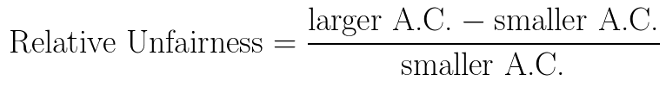
From Liberal Arts Mathematics Textbooks

Slide 15
Problem One: The outliers are the baseline.

Slide 16


New Definitions

Slide 17
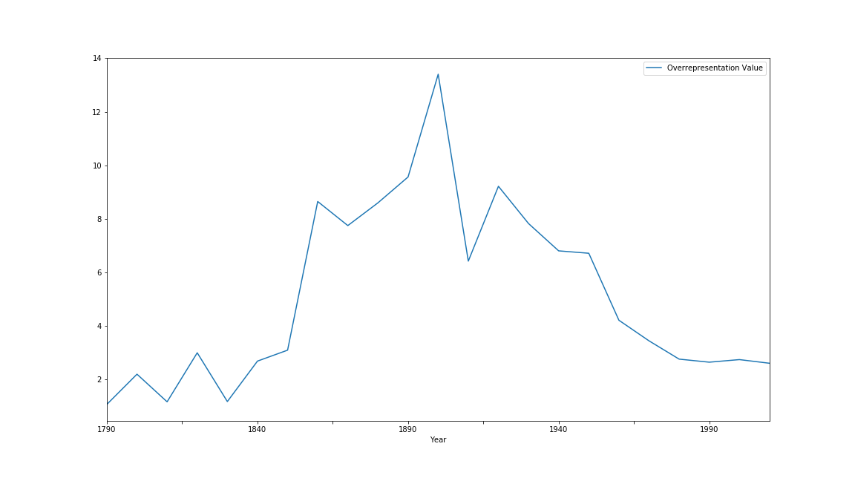
Overrepresentation vs. Decade

Slide 18
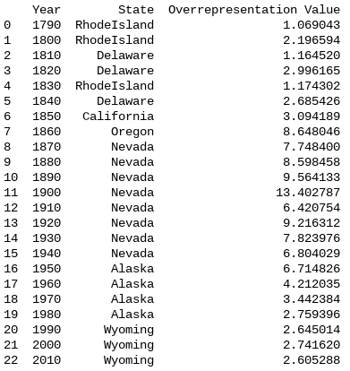
Best Represented States by Decade

Slide 19
Problem Two:
Can a few small, overrepresented states make the overall unfairness worse?

Slide 20
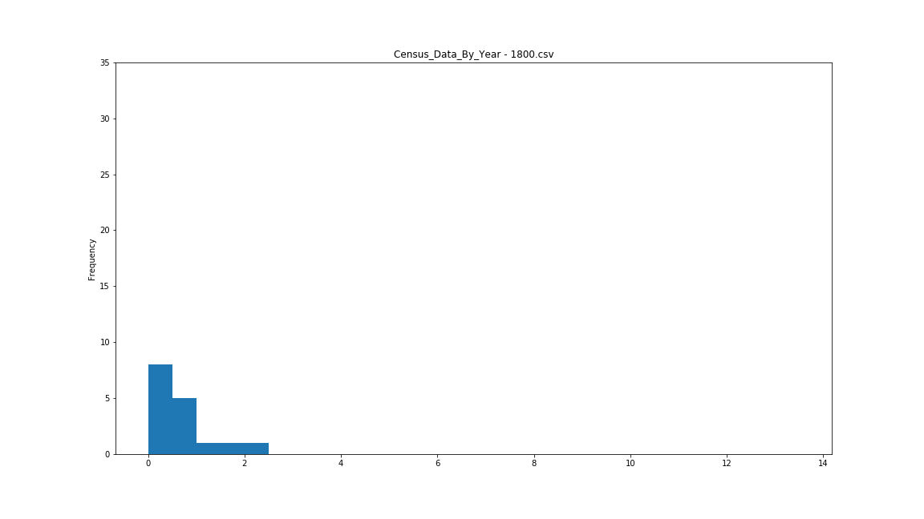
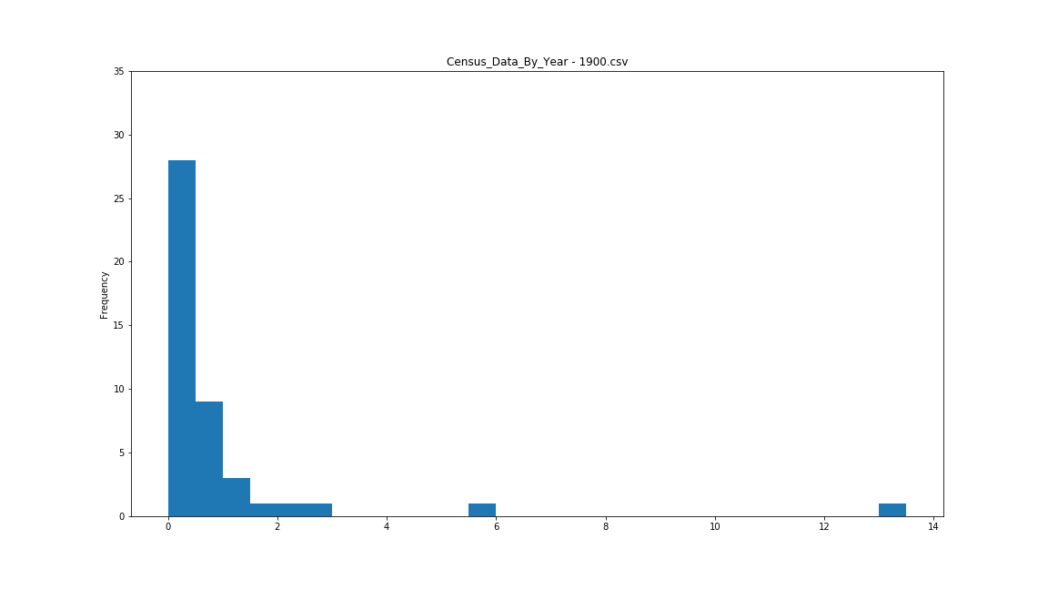
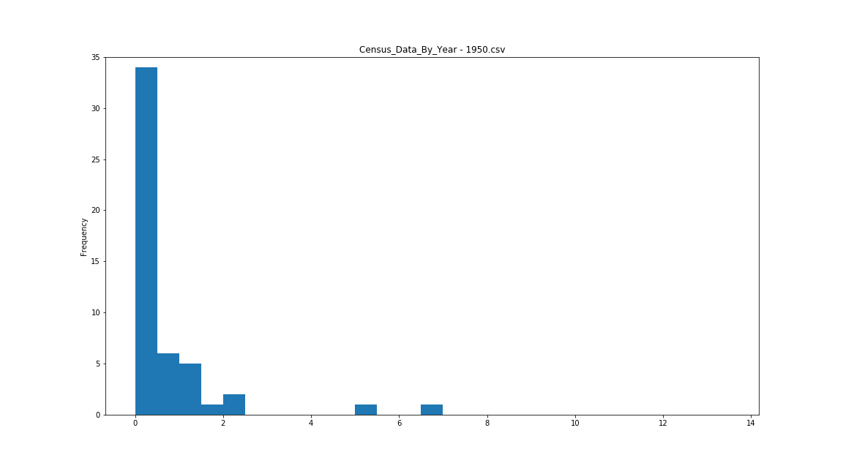
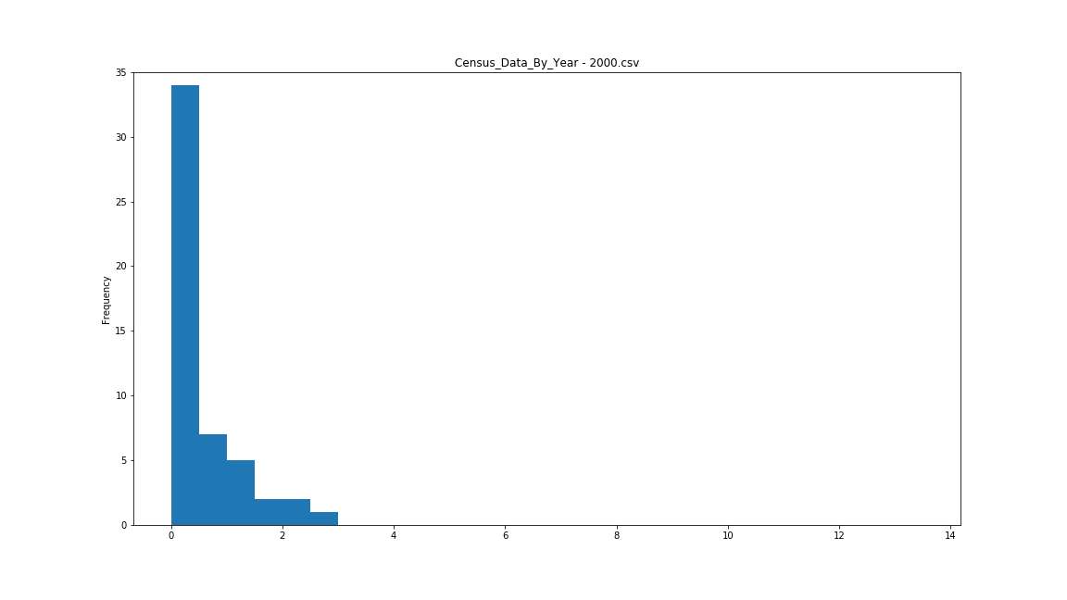
Is This Fair?

Slide 21

“Center of Mass” of Electoral College

Slide 22
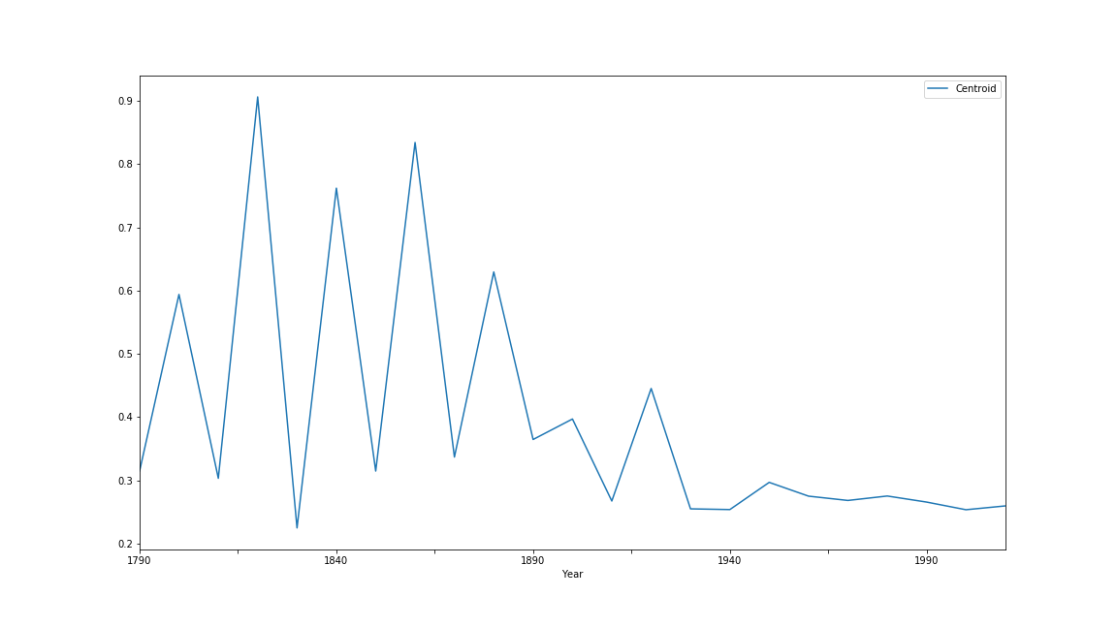
Centroid vs. Decade

Slide 23
Conclusion One:
The Electoral College is not getting more unfair over time.

Slide 24
Evening the Playing Field

Slide 25
Hypothesis Two:
If we increase the number of House Representatives, the Electoral College will be even more fair.

Slide 26
Reapportionment Act of 1929
Capped the number of members of House of Representatives to 435.
Briefly increased to 437 when Hawaii and Alaska were added.

Slide 27
Procedure
Apportion House Representatives until all states have at least two.
Distribute Electoral College votes as usual.

Slide 28
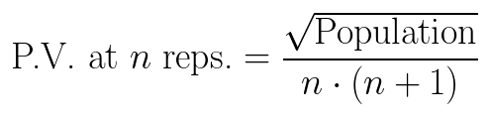
Huntington-Hill Apportionment
Every state starts with one representative.
Representatives are added according to priority values, highest to lowest.

Slide 29
Maxing Out 1990 Apportionment
Hypothesis:
If we increase the 1990 apportionment, then Al Gore will win the 2000 election.

Slide 30

1990 Fairness

Slide 31
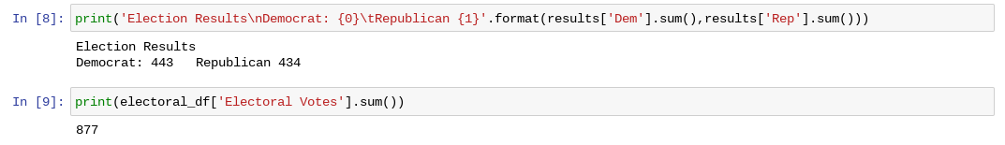
2000 Results

Slide 32
Maxing Out 2010 Apportionment
Hypothesis:
If we increase the 2010 apportionment, then Hillary Clinton will win the 2016 election.

Slide 33
2010 Fairness

Slide 34
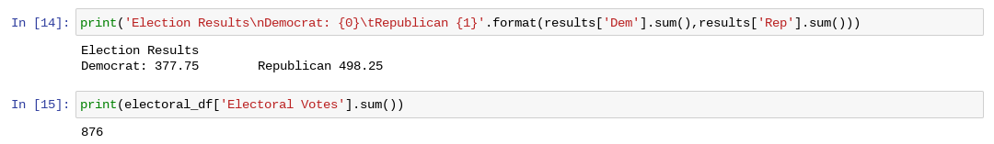
2016 Results

Slide 35
Conclusion Two:
Increasing the number of House Representatives makes the distribution more fair, but the Electoral College does not always conform to the population vote.

Slide 36
Winner Take Some

Slide 37
Hypothesis Three:
Splitting Electoral College votes for each state proportional to the votes will match the popular vote.

Slide 38
Procedure
Apportion Electoral College votes as usual.
Apportion votes for each state according to Huntington-Hill.

Slide 39

2016 Results

Slide 40

Election Goes to Congress
Creator: © Jonathan Ernst / Reuters
Credit: REUTERS

Slide 41
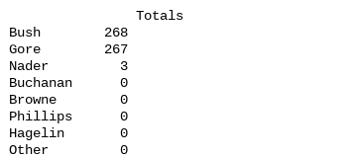
2000 Results

Slide 42
Election Goes to Congress
House of Representatives: Bush wins.
Senate: ¯\_(ツ)_/¯

Slide 43

1992 Results

Slide 44
Election Goes to Congress
House of Representatives: Clinton wins.
Senate: Gore wins.

Slide 45
Conclusion Three:
Distributing Electors proportionally will lead to fewer majority winners.

Slide 46

Is there any scenario where Clinton wins?

Slide 47

2016 with Expanded Apportionment

Slide 48
Future Projects

Slide 49
Where to go from Here?
Effects of increasing House Members on gerrymandering
Add better data sources
See if anyone else has done this

Slide 50
Questions

